Slide 1

SESV: Accurate Medical Image Segmentation by Predicting and Correcting Errors
Authors: Yutong Xie, Jianpeng Zhang, Hao Lu, Chunhua Shen, and Yong Xia
Presented by
Abu Noman Md Sakib
Graduate Teaching Assistant
Department of Computer Science
May 6, 2025

Slide 2
Outline
Introduction
Related Works
Methodology
Results
Conclusion
1
One UTSA Circle • San Antonio, Texas 78249

Slide 3
Introduction
Motivation & Clinical Importance
Importance of accurate medical image segmentation in diagnostics
Challenges with manual segmentation
Time-consuming
Limited training data
Subjective variability
Need for automated methods that improve accuracy for clinical use
2
One UTSA Circle • San Antonio, Texas 78249

Slide 4
Introduction
Research Problem & Objectives
Limitations of current DCNN-based segmentation methods
Main challenge: segmentation inaccuracies caused by limited data and complex anatomy
Objective: Improve the segmentation accuracy without designing a completely new model
3
One UTSA Circle • San Antonio, Texas 78249

Slide 5
Introduction
Related Works
Methodology
Results
Conclusion
4
One UTSA Circle • San Antonio, Texas 78249

Slide 6
Related Works
Conventional Approaches:
Hand-crafted features and traditional segmentation methods
Deep Learning Methods:
DCNN-based approaches (e.g., U-Net, DeepLabv3+) have improved performance
Error Prediction & Correction:
Previous works using user interactions or direct error correction have limitations
Gap Identified:
Need for a framework that can automatically predict and correct segmentation errors robustly
5
One UTSA Circle • San Antonio, Texas 78249

Slide 7
Introduction
Related Works
Methodology
Results
Conclusion
6
One UTSA Circle • San Antonio, Texas 78249

Slide 8
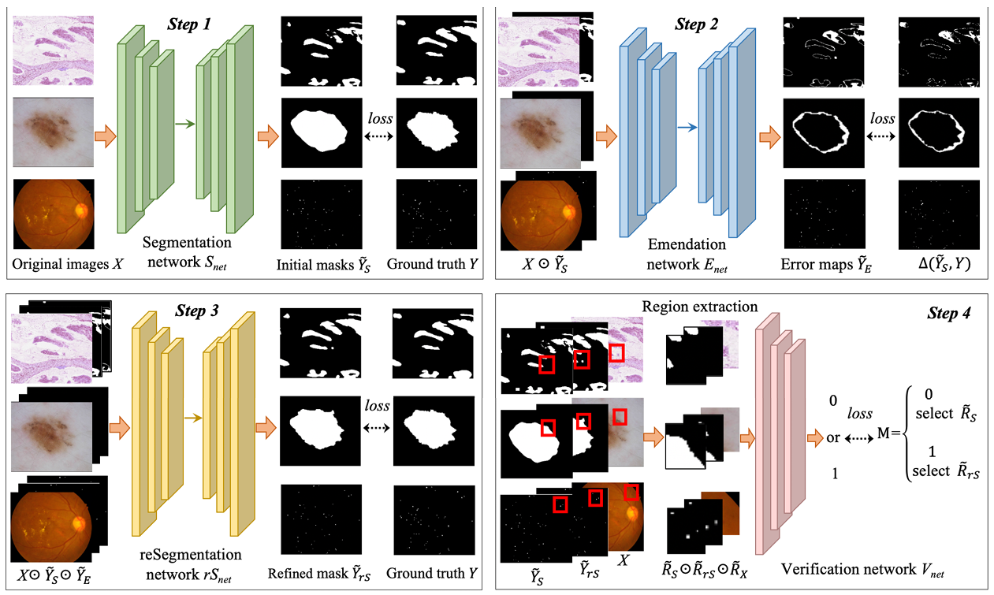
Methodology
Proposed SESV Framework
Fig. 1. Technical pipeline of the proposed SESV framework (Segmentation – Emendation – reSegmentation - Verification).
7
One UTSA Circle • San Antonio, Texas 78249

Slide 9
Methodology
Proposed SESV Framework
Framework Components:
Segmentation Network (Snet): Generates initial segmentation mask
Emendation Network (Enet): Predicts segmentation error map
Re-segmentation Network (rSnet): Refines the initial mask using the error map as a prior
Verification Network (Vnet): Verifies the refined regions and selects the best output
Key Idea:
Correcting segmentation errors by predicting where they occur
Use verification to filter out incorrectly refined regions
8
One UTSA Circle • San Antonio, Texas 78249

Slide 10
Methodology
Technical Details
Error Prediction:
Enet predicts a binary error map, marking potential mis-segmented pixels
Combines class-weighted Dice loss and cross-entropy loss to handle class imbalance
Re-segmentation Strategy:
rSnet takes as input the original image, initial segmentation mask, and error map
Produces a refined mask, aiming to correct mis-segmented areas
Verification Process:
Vnet evaluates local regions to decide whether to accept or reject the refined output
Helps mitigate the propagation of errors from less accurate predictions
9
One UTSA Circle • San Antonio, Texas 78249

Slide 11
Introduction
Related Works
Methodology
Results
Conclusion
10
One UTSA Circle • San Antonio, Texas 78249

Slide 12
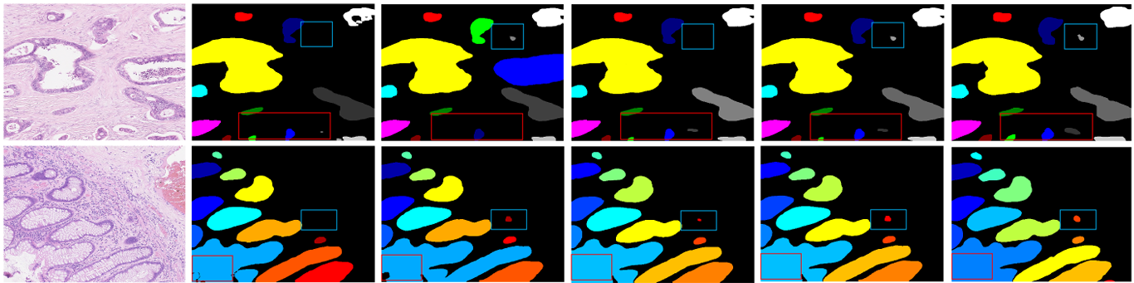
Results
Experimental Setup
Datasets:
Gland segmentation (CRAG dataset)
Skin lesion segmentation (ISIC-2017 and ISIC-2018 datasets)
Retinal microaneurysms segmentation (IDRiD dataset)
Fig. 2. Sample examples of dataset and output.
11
One UTSA Circle • San Antonio, Texas 78249

Slide 13
Results
Key Metrics & Performance Highlights
Key Metrics:
Improvement in object-level F1 score (O-F1), Dice coefficient (O-Dice), and Hausdorff distance
Notable performance gains over base segmentation models (e.g., DeepLabv3+) and competitive methods
Performance Highlights:
Consistent improvements across different segmentation tasks and networks
Achieves state-of-the-art or near state-of-the-art results among published methods
12
One UTSA Circle • San Antonio, Texas 78249

Slide 14
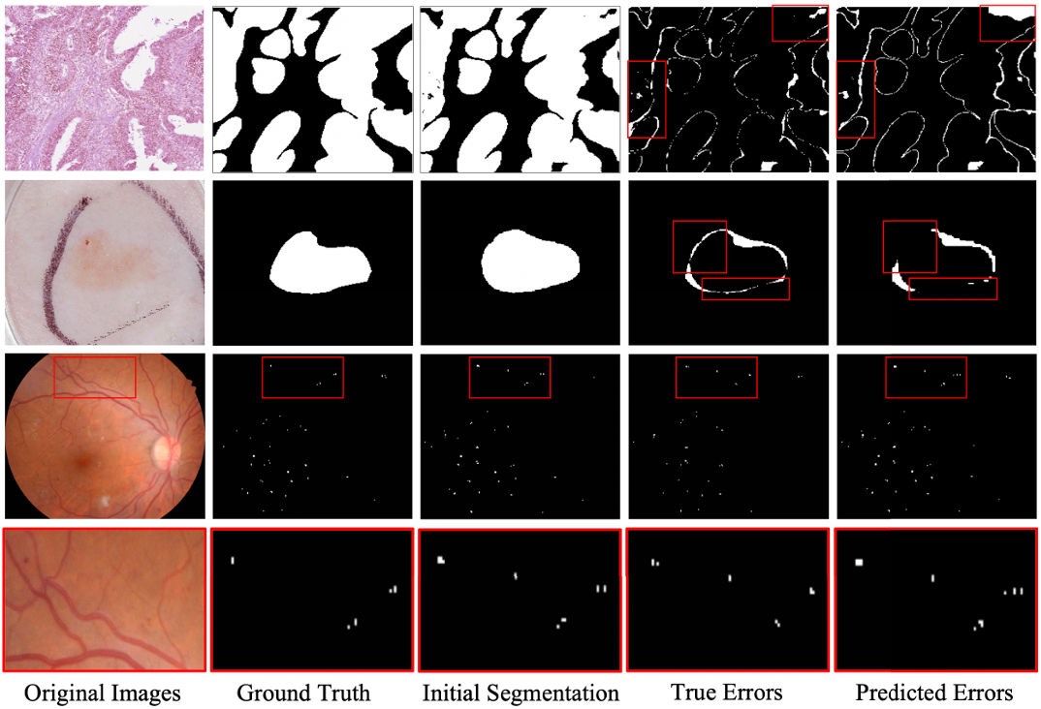
Results
Experimental Data
Fig. 3. Three examples and their predicted segmentation error maps, which could be incorrect in some regions (highlighted by red rectangles).
13
One UTSA Circle • San Antonio, Texas 78249

Slide 15
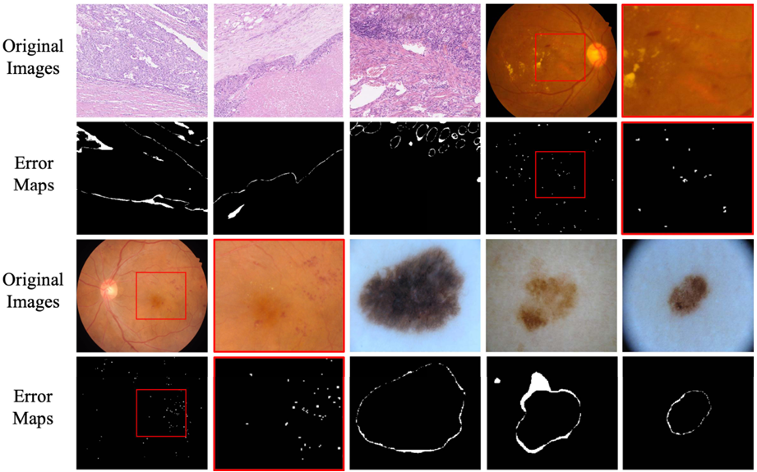
Results
Experimental Data
Fig. 4. Visualization of segmentation error maps chosen from three different datasets. It shows that incorrectly segmented pixels (with a value of 1) are significantly less than correctly segmented pixels (with a value of 0).
14
One UTSA Circle • San Antonio, Texas 78249

Slide 16
Quantitative Results
Models | Networks |  |  |  | CRAG |  |  | ISIC-2017 |  |  |  |  | IDRiD
 | Snet | Enet | rSnet | Vnet | O-F1 | O-Dice | O-Hausdorff | Jac | Dice | Acc | Sen | Spe | AUC-PR
I | ✓ | × | × | × | 77.89 | 85.01 | 151.51 | 77.62 | 85.83 | 93.82 | 87.84 | 96.13 | 48.65
II | ✓ | ✓ | × | × | 83.60 | 89.29 | 111.52 | 76.57 | 85.20 | 93.80 | 85.64 | 95.96 | 33.34
III | ✓ | ✓ | ✓ | × | 80.23 | 87.85 | 123.35 | 77.88 | 86.05 | 93.82 | 84.25 | 97.52 | 49.25
IV | ✓ | × | ✓ | × | 83.27 | 88.17 | 119.84 | 78.11 | 86.13 | 93.89 | 85.86 | 96.57 | 49.87
V | ✓ | ✓ | ✓ | ✓ | 84.44 | 89.67 | 108.84 | 78.30 | 86.45 | 94.00 | 88.08 | 95.58 | 50.21
SESV-DLab | ✓ | ✓ | ✓ | ✓ | 85.43 | 89.90 | 106.10 | 78.77 | 86.79 | 94.14 | 88.35 | 95.70 | 50.99
Table. 1. Performance of the proposed SESV Model under different settings on three datasets.
15
One UTSA Circle • San Antonio, Texas 78249

Slide 17
Quantitative Results
Snet | CRAG |  |  | ISIC-2017 |  |  |  |  | IDRiD
 | O-F1 | O-Dice | O-Hausdorff | Jac | Dice | Acc | Sen | Spe | AUC-PR
PSPNet | 69.47 | 77.15 | 210.92 | 70.19 | 79.87 | 92.21 | 77.62 | 97.82 | 46.03
SESV-PSP | 69.01 | 79.70 | 192.53 | 73.00 | 82.72 | 93.10 | 83.49 | 95.61 | 47.54
U-Net | 77.20 | 82.03 | 180.36 | 76.36 | 84.60 | 93.47 | 80.98 | 98.26 | 46.36
SESV-Unet | 78.17 | 86.67 | 135.08 | 78.19 | 86.14 | 94.17 | 84.40 | 97.48 | 48.21
FPN | 73.21 | 81.38 | 196.31 | 75.88 | 84.16 | 93.23 | 80.94 | 98.18 | 48.42
SESV-FPN | 76.29 | 83.98 | 153.70 | 78.19 | 86.29 | 94.18 | 85.07 | 96.57 | 50.54
Table. 2. Performance Improvement Obtained by applying SESV Framework on three datasets.
16
One UTSA Circle • San Antonio, Texas 78249

Slide 18
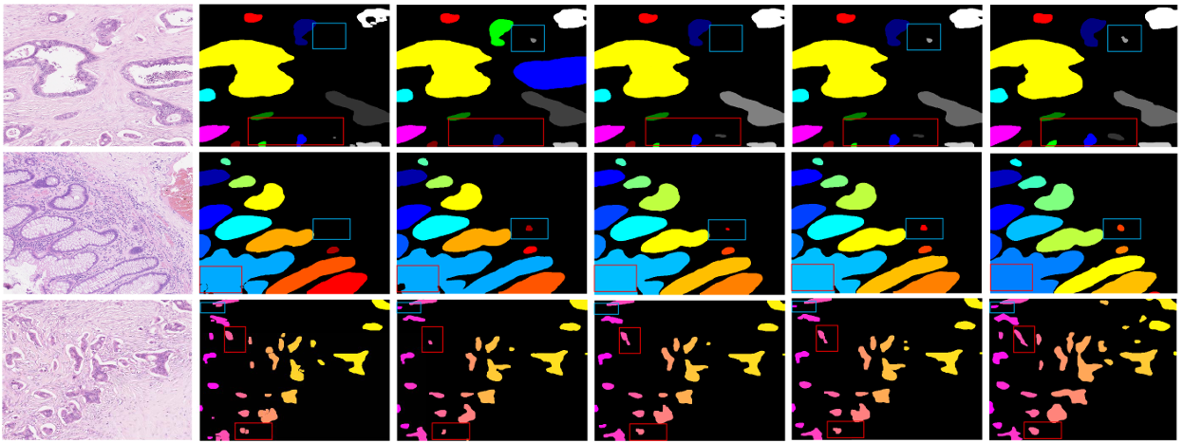
Qualitative Results
Fig. 5. Qualitative evaluation of segmentation results obtained on CRAG dataset.
17
One UTSA Circle • San Antonio, Texas 78249

Slide 19
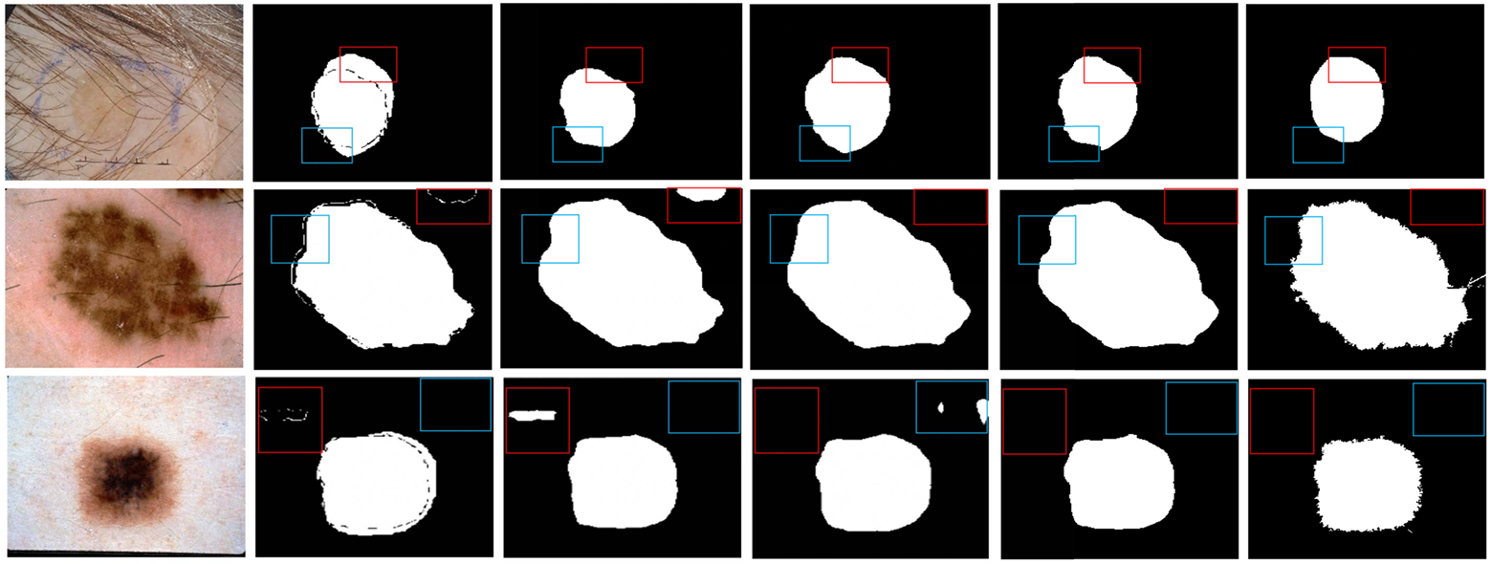
Qualitative Results
Fig. 6. Qualitative evaluation of segmentation results obtained on ISIC dataset.
18
One UTSA Circle • San Antonio, Texas 78249

Slide 20
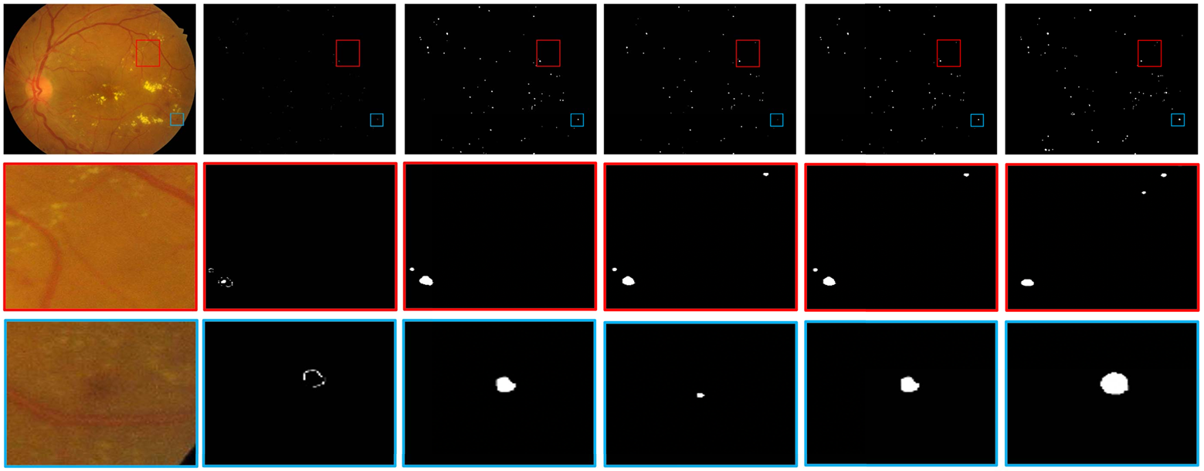
Qualitative Results
Fig. 7. Qualitative evaluation of segmentation results obtained on IDRiD dataset.
19
One UTSA Circle • San Antonio, Texas 78249

Slide 21
Introduction
Related Works
Methodology
Results
Conclusion
20
One UTSA Circle • San Antonio, Texas 78249

Slide 22
Conclusion
Discussion & Limitations
Innovative Aspects of SESV:
Integration of predicted error maps as priors rather than direct corrections
The re-segmentation strategy that corrects initial errors effectively
Verification network to guard against detrimental refinements
Comparative Analysis:
Outperforms direct error correction methods (e.g., DSE model)
Robust across various segmentation tasks and different base networks (e.g., PSPNet, U-Net, FPN)
Limitations:
Higher computational complexity and longer training time compared to base models
21
One UTSA Circle • San Antonio, Texas 78249

Slide 23
Conclusion
Contributions & Future Direction
Summary of Contributions:
Novel framework (SESV) that enhances segmentation accuracy by predicting and correcting errors
Demonstrated performance improvements in multiple medical image segmentation tasks
Future Directions:
Exploration into semi- and weakly-supervised settings to reduce reliance on pixel-wise annotation
Potential adaptations to reduce training cost and computational burden
Final Takeaway:
SESV provides a robust and effective strategy for improving clinical diagnostic segmentation systems
22
One UTSA Circle • San Antonio, Texas 78249

Slide 24
Q&A
Any Questions?
23
One UTSA Circle • San Antonio, Texas 78249

Slide 25
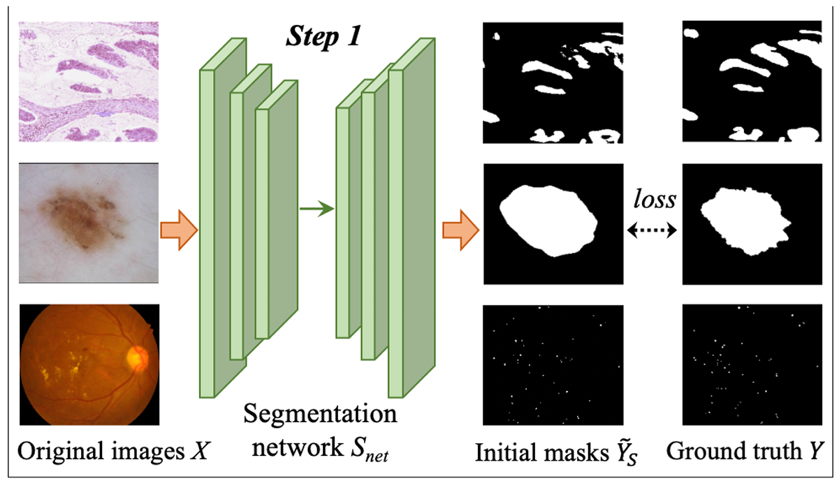
Methodology
Proposed SESV Framework
One UTSA Circle • San Antonio, Texas 78249

Slide 26
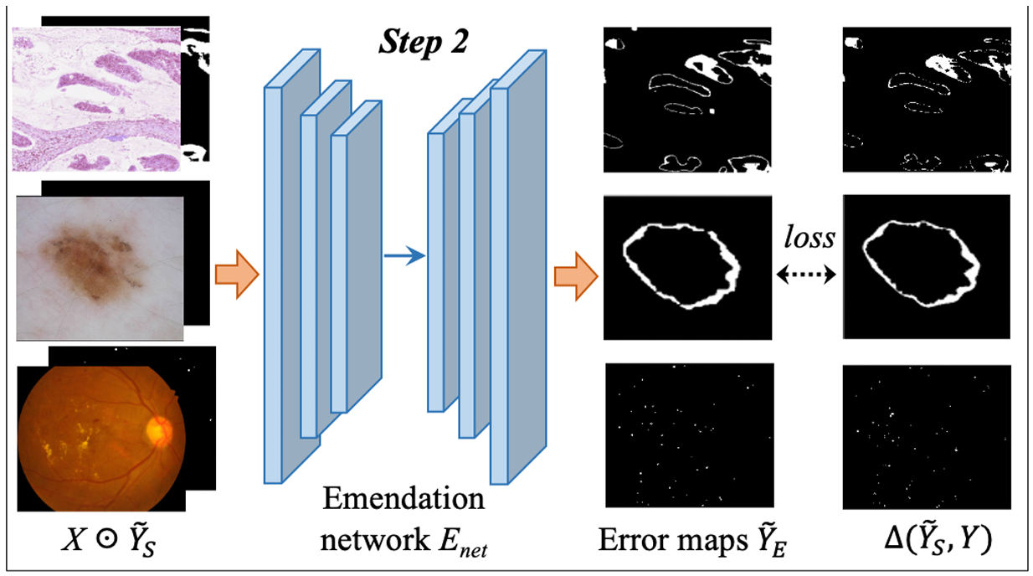
Methodology
Proposed SESV Framework
One UTSA Circle • San Antonio, Texas 78249

Slide 27
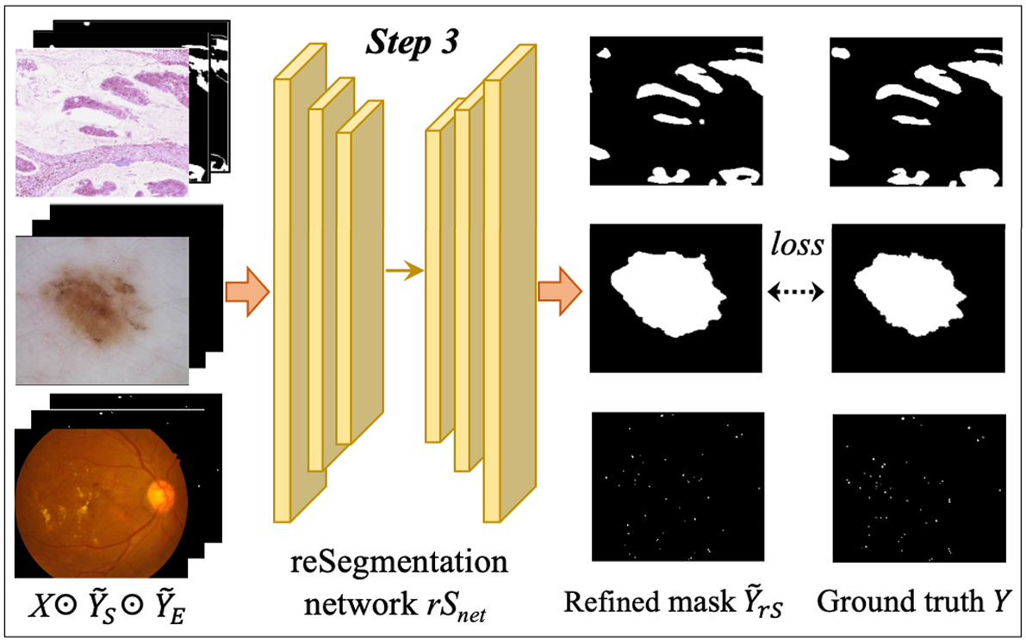
Methodology
Proposed SESV Framework
One UTSA Circle • San Antonio, Texas 78249

Slide 28
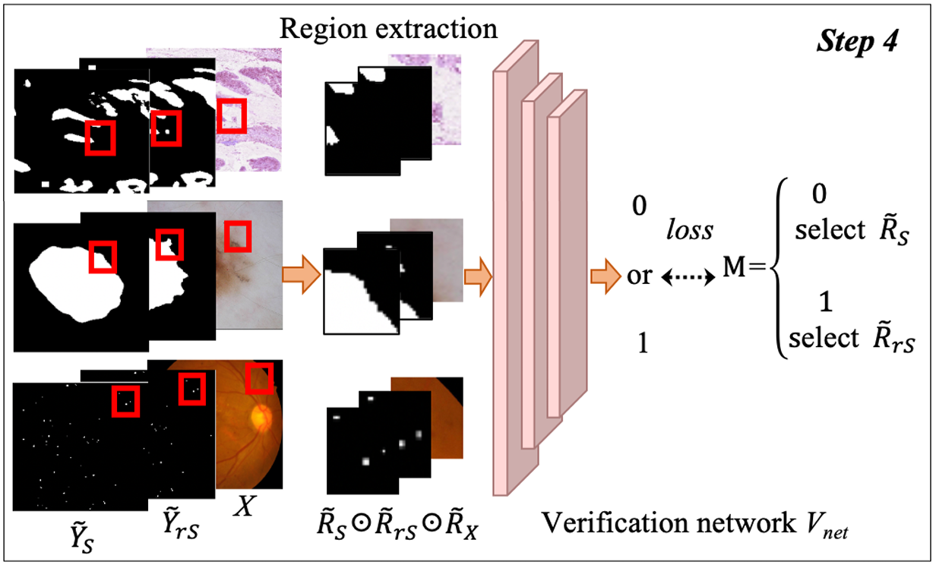
Methodology
Proposed SESV Framework
One UTSA Circle • San Antonio, Texas 78249

Slide 29
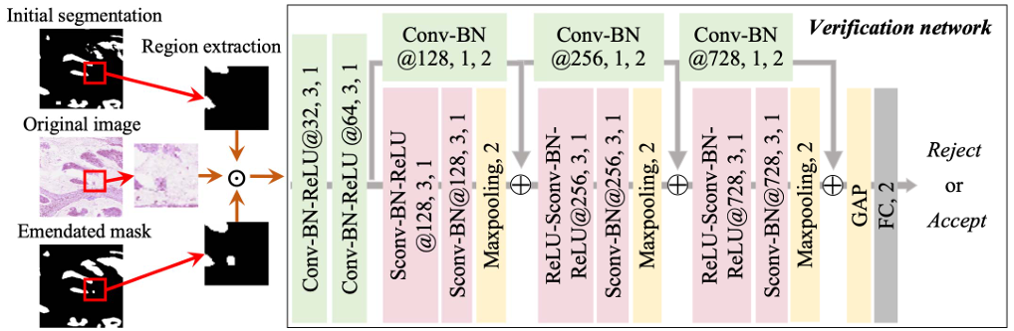
Methodology
Architecture of Vnet
One UTSA Circle • San Antonio, Texas 78249

